Slide 1

Secondary PowerPoint 7:
The Voting Process

Slide 2

Why do you think it is important to VOTE?

Slide 3

Elections are the process where citizens have the greatest influence on their government and legislation.

Slide 4

Who is responsible for running provincial elections in B.C.?
Elections in British Columbia are conducted by Elections BC, an independent and non-partisan Office of the Legislative Assembly, under the direction of the Chief Electoral Officer.
This ensures that elections are conducted in a fair and unbiased manner.
www.elections.bc.ca
Notes:
4

Slide 5

Fixed-Date Elections
British Columbia was the first jurisdiction in Canada to adopt fixed-date elections.
Beginning in 2005, the Constitution Act has called for provincial general elections to take place on the second Tuesday in May every four years.
As a result, the 41st British Columbia general election will take place on Tuesday, May 9.

Slide 6
How do you know if you are eligible to vote?
What do you need in order to vote?

Slide 7
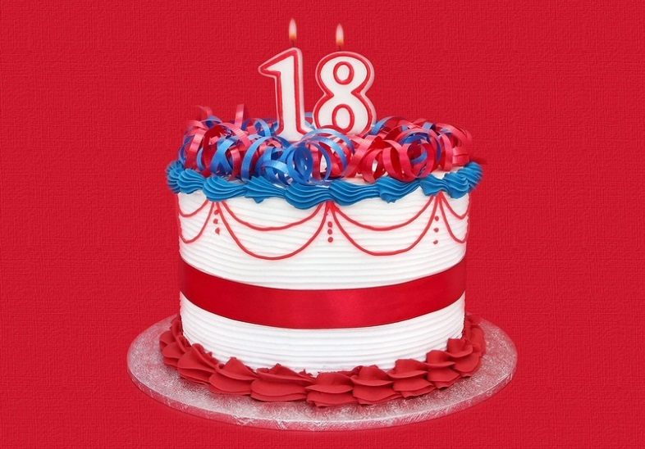
Who is eligible to vote?
You are qualified to vote in a BC provincial election if:
  You are a Canadian citizen;
  You are 18 years of age on General Voting Day;
  You have been a resident of British Columbia for at least six months prior to voting day.

Slide 8
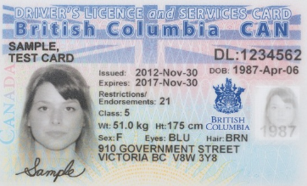
Voter identification
The Election Act requires that voters prove their identity and residential address in order to receive a ballot or register to vote. You have three options:
  One document issued by the Government of B.C. or Canada that contains the voter’s name, photograph and residential address, such as a B.C. driver’s license or B.C. Identification Card (BCID)
  A Certificate of Indian Status
  Two documents that contain the voter’s name (at least one of the documents must also contain the voter’s residential address)

Slide 9
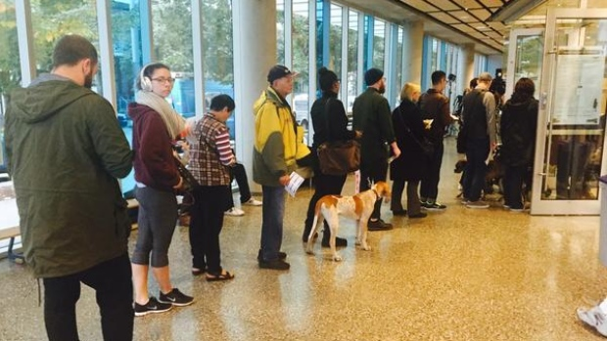
Getting on the voters list
Elections BC maintains a voters list, which includes the name and address of registered eligible voters.
Before an election is called, you can register to vote using Elections BC’s online registration system or by contacting their local office.
During an election, you can also register as a voter at the voting place prior to casting your ballot.

Slide 10
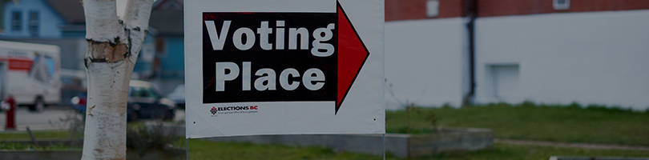
Where do I vote?
Each electoral district is divided into smaller voting areas.
Eligible voters can vote at the voting place designated for their voting area or at any other voting place in the province.

Slide 11
There are four different ways you can choose to vote in a B.C. provincial election.
Do you know what they are?

Slide 12
Voters may choose to vote in one of four ways:
At advance voting — Advance voting locations are open on the Saturday and Sunday two weeks before General Voting Day, and the Wednesday, Thursday, Friday and Saturday before General Voting Day.
On General Voting Day — General voting places are open from 8 a.m. and 8 p.m., Pacific time on General Voting Day.
At any district electoral office — From when an election is called to 4 p.m. on General Voting Day.
Vote by mail — Voters can ask for a vote by mail package from before an election is called until 4 p.m. on General Voting Day. The completed package must be returned to the district electoral office by 8 p.m. on General Voting Day.

Slide 13
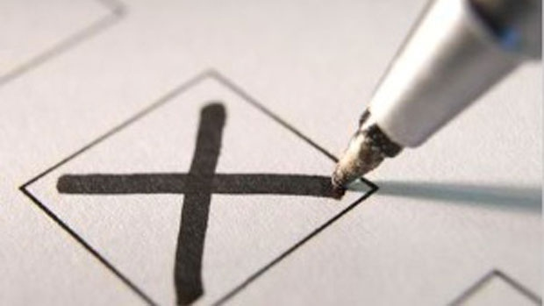
How do I mark my ballot?
A ballot lists the names of the candidates running in your electoral district and their party affiliation (where applicable).
The voter must clearly mark the ballot for one candidate for it to be accepted (e.g., checkmark, X, shading in).
Voting is done by secret ballot. No one except the voter knows the choice that was made.

Slide 14
Why is it important that we vote by secret ballot?
What could the consequences be if elections were held publicly?

Slide 15
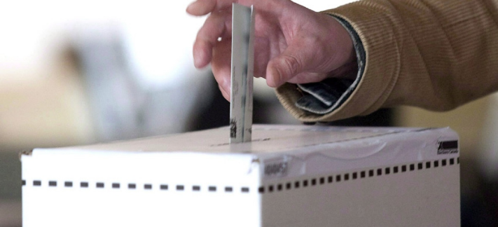
How does the voting process work?
The voting process at a voting place works as follows:
Once you confirm your eligibility, you are given a ballot initialed by the election official.
Go behind a voting screen to mark your ballot. Choose only one candidate on the ballot.
Hand your folded ballot back to the voting officer to check for the initials.
Place your folded ballot in the ballot box.

Slide 16
Rejected and Spoiled Ballots
A rejected ballot is a ballot that cannot be counted because the voter’s intention cannot be interpreted from the mark on the ballot.
  This can include marking the ballot for more than one candidate (even if different symbols are used), ranking the candidates, leaving the ballot blank or identifying who the voter is.
A spoiled ballot is a ballot that is torn or marked mistakenly and exchanged for a new ballot. It is kept separate and not placed in the ballot box.

Slide 17
How do you know if you are ready to vote?

Slide 18
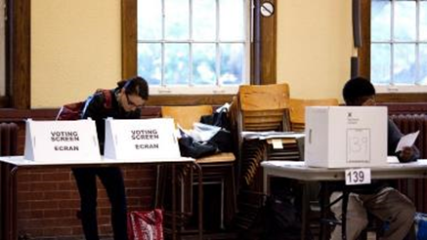
Making Your Decision
When preparing to vote, you can consider reasons to support a candidate for MLA, a political party or leader, a specific policy idea or a whole party platform.
Voting requires that you do your research and devote the necessary time.
You will know you are ready to vote when you feel confident in your ability to make a choice.

Slide 19
Debrief
How do you know if you are ready to vote?
Why is voting important?
Should young people be allowed to vote?

